Slide 1
Afinando el código paralelo con Intel® Parallel Amplifier

Slide 2
Objetivos
Al término de este módulo será capaz de…
  Usar Parallel Amplifier para encontrar y arreglar problemas de rendimiento comunes en aplicaciones con hilos
Notes:
Intel Parallel Amplifier Speaker’s Notes
Purpose of the Slide
Standard objectives slide.

Slide 3
Agenda
Vista a lo que ofrece Intel® Parallel Amplifier
Examinar las pantallas de datos disponibles del Parallel Amplifier
Revisar problemas de rendimientos comunes en aplicaciones multihilos
  Enfocarse en desbalanceo de carga
  Enfocarse en contención de sincronización
Describir las optimizaciones generales para mejorar el rendimiento
Notes:
Intel Parallel Amplifier Speaker’s Notes
Purpose of the Slide
Put forth the agenda of topics to be covered in this module.

Slide 4
Motivación
Desarrollar aplicaciones multihilos eficientes es difícil
Nuevos problemas de rendimiento son producto de la interacción de hilos concurrentes
  Carga desbalanceada
  Contención de objetos de sincronización
  Sobrecarga de la paralelización
Notes:
Intel Parallel Amplifier Speaker’s Notes
Purpose of the Slide
Provide some motivation to studying the Intel Parallel Amplifier.
Details
Not only is it hard to get correctly threaded applications, but efficient applications are hard to produce by hand without help. The list is some of the performance problems posed by multithreaded apps that are not found in serial codes.

Slide 5
Intel® Parallel Amplifier
Herramienta de depuración para software multihilos
  Plug-in para Microsoft* Visual Studio*
Identifica problemas de rendimiento en programas multihilos con OpenMP*, Intel® Threading Building Blocks, e hilos nativos
Localiza cuellos de botella que afectan directamente el tiempo de ejecución
Notes:
Intel Parallel Amplifier Speaker’s Notes
Purpose of the Slide
Provide some background and introduction to the Intel Parallel Amplifier.
Details
Works on the three most prevalent threading models.

Slide 6
Características de Intel® Parallel Amplifier
Integrado en Microsoft Visual Studio .NET* IDE
Suporta diferentes compiladores
  Microsoft* Visual* C++ .NET*
  GNU C
  Intel Parallel Composer
Instrumentación binaria de aplicaciones
Diferentes pantallas y filtros disponibles para asistir y organizar el análisis
  Analizador de Concurrencia – ¿Qué tan bien se están utilizando los recursos (core)?
  Analizador de Locks y Waits – ¿Dónde está esperando el programa?
Notes:
Intel Parallel Amplifier Speaker’s Notes
Purpose of the Slide
Provide information on supported compilers and some of the features of the tool.
Details
Parallel Amplifier has three separate analysis tools available.
Hotspots (not mentioned in this module) – Does a serial profiling of the application to find where in the code most of the execution time is spent.
Concurrency – determine how well the threaded application is using the set of cores available on the system
Locks and Waits – Look for synchronization objects that can cause the threads to sit idle or wait for overly long periods of time

Slide 7
Iniciando con Parallel Amplifier
Construir la aplicación
  Generar código con símbolos (-g)
Usar una carga de trabajo más pequeña, pero representativa
  No demasiado grande ya que el tiempo de ejecución se incrementa
  No demasiado pequeña para asegurarse que los problemas de rendimiento serán evidentes
Notes:
Intel Parallel Amplifier Speaker’s Notes
Purpose of the Slide
Provide information on getting application prepared for Parallel Amplifier analysis.
Details
Best to use the Release build configuration in order to take advantage of the optimizations that are included. Still need to add debugging symbols (/ZI), use the DLL run time library (/MD), link with debug symbols (/DEBUG), and ensure code is relocatable (/FIXED:NO)
If the workload is too small, there may not be enough thread interactions for problems to be detected. Cut down overall workload, but keep it relevant. For example, rather than computing on 10 million data items, reduce the workload to 1 million.

Slide 8
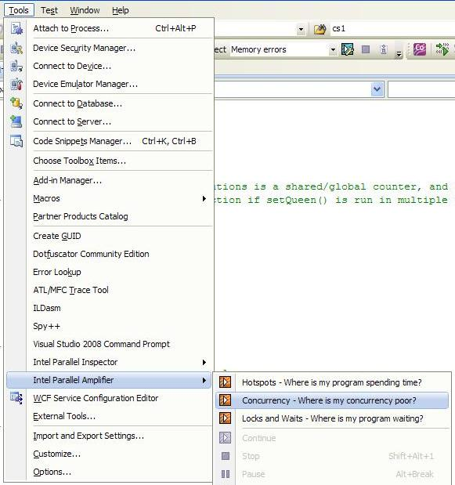
Iniciando con Parallel Amplifier
Después de la compilación, escoger el tipo de análisis en el menú Tools -> Parallel Amplifier
Notes:
Intel Parallel Amplifier Speaker’s Notes
Purpose of the Slide
Provide information on choosing Parallel Amplifier analysis to be performed on application.

Slide 9
Actividad 1a
Versión multihilos del código “friendly numbers”
  ¿Hay un problema de rendimiento?
Meta
  Ejecuta la aplicación a través de Parallel Amplifier
    Concurrencia
    Locks y Waits
  Examina las actividades de los hilos usando diferentes herramientas de análisis y revisando las diferentes pantallas disponibles de esta herramienta
Notes:
Intel Parallel Amplifier Speaker’s Notes
Purpose of the Slide
Introduce the first part of the First Lab Activity.

Slide 10
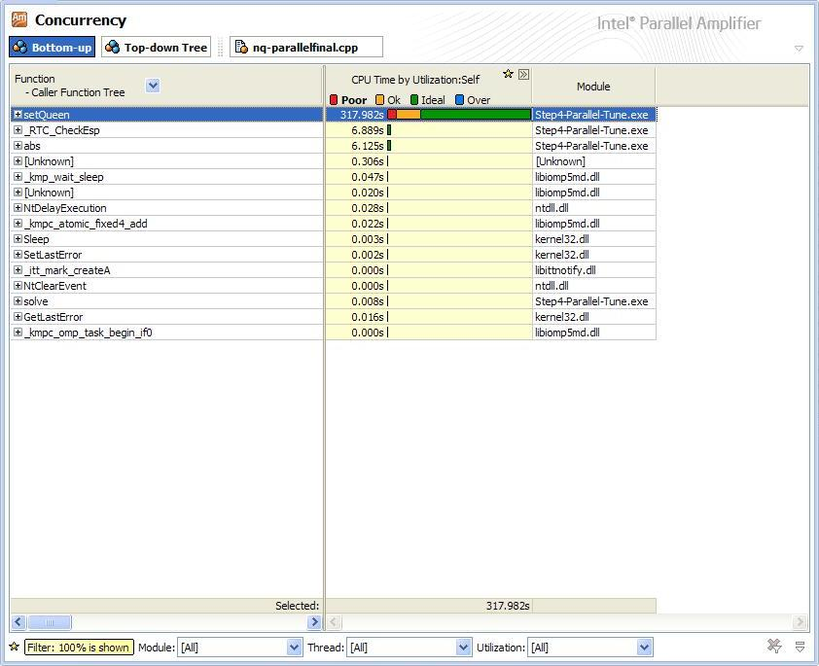
Parallel Amplifier: Informes de Concurrencia
El panel de Análisis de Concurrencia por default muestra Bottom-up
  Organizado por función
  El histograma muestra la cantidad de concurrencia dentro de una función durante la ejecución
  Se usan colores para distinguir el nivel de concurrencia para la plataforma donde se ejecuta
Notes:
Intel Parallel Amplifier Speaker’s Notes
Purpose of the Slide
Describe the main pane displayed in the Concurrency Analysis within Parallel Amplifier.
Details
This example comes from the N-Queen sample problem that is shipped with Parallel Studio. The results were taken from runs on a Nehalem platform with 8 cores (16 threads).
Use this window to focus on the time-consuming functions with poor utilization. Typically, the Concurrency: Bottom-up window is the first window you look at after an analysis run.
The Function column shows the list of functions in the program. Click the plus sign to expand the row to show a summary of the stacks that called this function. The full information on the stack is shown in the Call Stack tab.
The CPU Time by Utilization column shows the utilization of the processors for the selected program unit. bars showing OK or Ideal utilization (green by
default) are utilizing the processors well, other bars indicate program units that can be optimized.
The Module column shows a list of the modules that contain the functions in the program.
Transition Quote
“Before we look at the source code window, let’s take a look at the Top-down Tree View.”

Slide 11
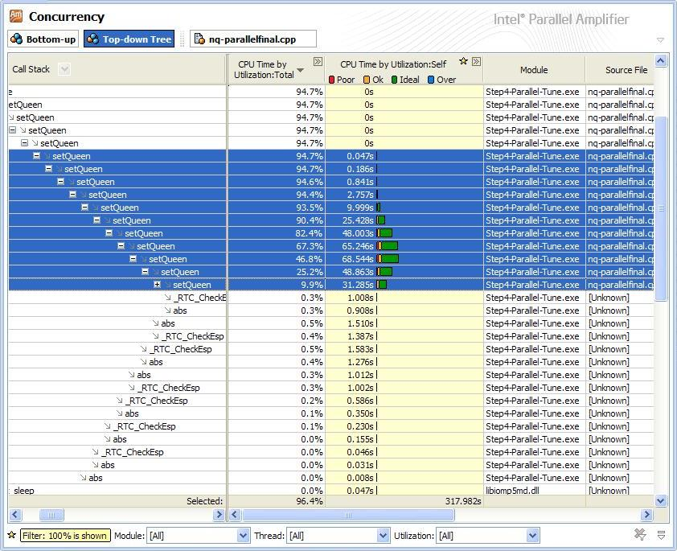
Parallel Amplifier: Informes de Concurrencia
Árbol Top-down
  Muestra el árbol de llamadas a los puntos
  Muestra en un árbol de llamadas la ruta a los puntos dentro de la ejecución y los niveles de concurrencia de dichas funciones.
  Nota: la sección resaltada (azul) corresponde a la función resaltada en la pantalla Bottom-up
Notes:
Intel Parallel Amplifier Speaker’s Notes
Purpose of the Slide
Describe the Top-down Tree Tab pane displayed in the Concurrency Analysis within Parallel Amplifier.
Details
Click the Concurrency: Top-down Tree tab to open the Top-down Tree window for this analysis run. Use this window to see the call sequence to the functions that were not concurrent. This view could give the programmer knowledge as to where the lower levels of concurrency were located and how the program got to those portions of code.
Transition Quote
“Let’s look at the source code window, which we get from double-clicking on a function of interest.”

Slide 12
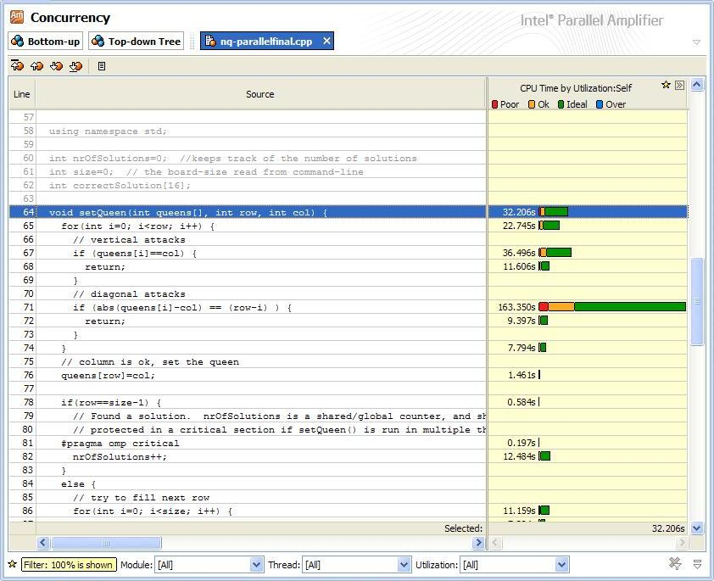
Parallel Amplifier: Informes de Concurrencia
Source code Tab
  Muestra el código fuente de la función seleccionada
  Concurrencia desde las líneas ejecutadas mostradas en la columna “CPU Time”
Notes:
Intel Parallel Amplifier Speaker’s Notes
Purpose of the Slide
Describe the source code pane displayed in the Concurrency Analysis within Parallel Amplifier.
Details
The execution time of source lines with concurrency levels is featured in CPU Time by Utilization: Self column.
Transition Quote
“Let’s look at the Summary graph located in the lower right corner of the Parallel Studio window.”

Slide 13
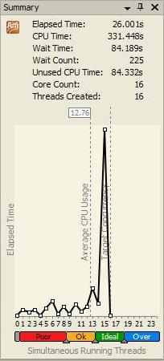
Parallel Amplifier: Informes de Concurrencia
Pánel de Gráfica de resumen
  La sección de texto resume los datos de concurrencia en la parte de arriba del pánel
  La sección de la gráfica muestra la cantidad de tiempo gastado por la aplicación ejecutando los niveles de concurencia dados
    Tiempo promedio de uso del CPU se mide en la eficiencia paralela
    Podemos obtener detalles posicionando el ratón sobre los cuadros en la gráfica
Notes:
Intel Parallel Amplifier Speaker’s Notes
Purpose of the Slide
Describe the Summary pane displayed in the Concurrency Analysis within Parallel Amplifier.
Details
Elapsed Time - The overall amount of time your program ran in hours/min/sec.
CPU/Wait Time - The overall amount of processor time spent by the program. This is the sum of all the time that all the processors were active or waiting.
Pause Time- The amount of elapsed time that you paused the analysis.
CPU Utilization Ratio - The white box (Average CPU Usage) indicates the processor utilization. This value is similar to average number of simultaneously running threads during collection. However, time with running threads above the target concurrency, is calculated as target concurrency.
Utilization Indicator bar - This bar indicates the utilization levels for threads running simultaneously. The number of Simultaneous Running Threads shown in the Graph and bar equals the target concurrency x 1.5. In the example in the slide, the target concurrency is sixteen logical CPUs, the bar shows 24 threads. You can configure the utilization levels by moving the control handles between bars. The Summary tab and the related windows are automatically updated. However, new results will use the default values.
Transition Quote
“Let’s look at the Locks and Waits analysis results within Parallel Amplifier.”

Slide 14
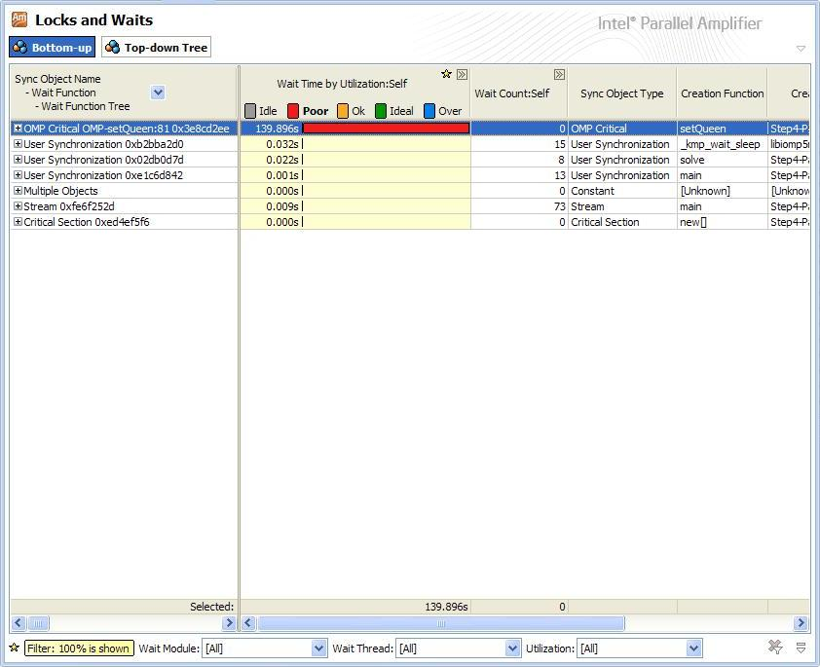
Parallel Amplifier: Pantalla de Locks y Waits
El pánel de análisis de Locks y Waits muestra por default Bottom-up
  Organizado por objeto
  El histograma muestra la cantidad de tiempo que los hilos experimentan dentro de una función durante la ejecución
  Se usan colores para distinguir nivel de concurrencia
Notes:
Intel Parallel Amplifier Speaker’s Notes
Purpose of the Slide
Describe the default pane displayed in the Locks and Waits Analysis within Parallel Amplifier.
Details
The Locks and Waits analysis shows you where your program is waiting for synchronization of the different code elements together with information on the utilization of available logical processors. It collects and displays information on the utilization of logical processors for each synchronization object in your program, grouped by thread, wait function, wait module, wait call stack, and signal call stack.
The windows in the Locks and Waits result tab show information on the synchronization objects that control the threads in your application. If you use OpenMP* or Intel(R) Threading Building Blocks to generate threads for your application, these windows show objects relating to these threading tools.
Users should focus tuning efforts on the synchronization objects that have high value, especially if they have poor utilization.
Transition Quote
“Before we look at the source code window, let’s take a look at the Top-down Tree View.”

Slide 15
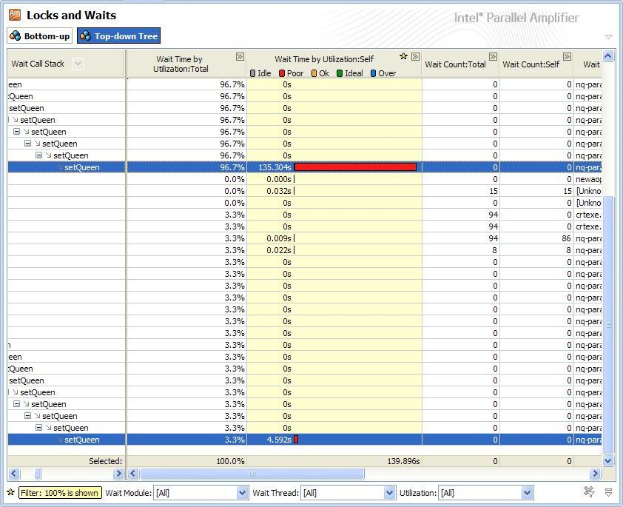
Parallel Amplifier: Pantalla de Locks y Waits
Árbol Top-down
  Muestra la ruta en el árbol de llamadas a los puntos dentro de la ejecución y el tiempo de espera causado por objetos de sincronización o funciones de E/S
Notes:
Intel Parallel Amplifier Speaker’s Notes
Purpose of the Slide
Describe the default pane displayed in the Locks and Waits Analysis within Parallel Amplifier.
Details
Use this window to see the call sequence to the functions that were waiting on a synchronization object or an input or output function.
The view shown in the slide indicates that the OpenMP critical construct isn’t needed until the end of the recursive search for a queen placement. This is indicated by all the Wait Time being listed on the last recursive call of setQueen().
Transition Quote
“Let’s look at the source code window, which we get from double-clicking on an object of interest from the Bottom-up view.”

Slide 16
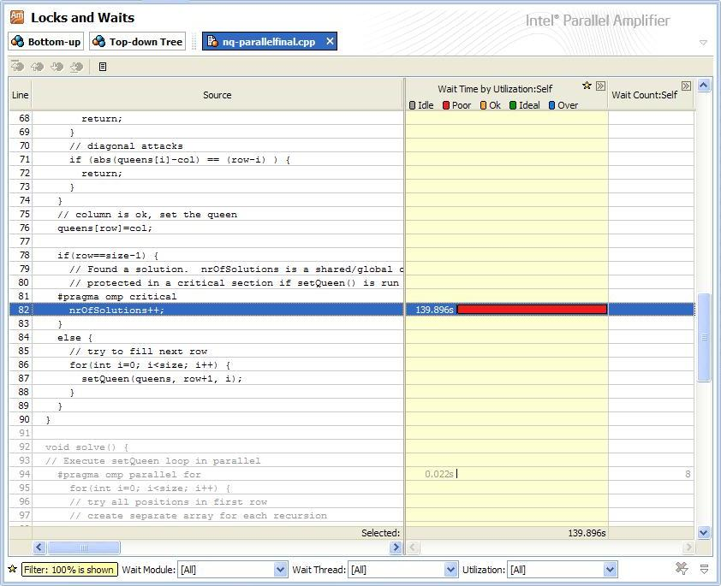
Parallel Amplifier: Pantalla de Locks y Waits
Source code Tab
  Muestra las líneas de código fuenta involucradas en regiones críticas de código protegidas por objetos de sincronización identificadas por el Amplifier
Notes:
Intel Parallel Amplifier Speaker’s Notes
Purpose of the Slide
Describe the source code tab displayed in the Locks and Waits Analysis within Parallel Amplifier.
Transition Quote
“Next is the second part to the First Activity.”

Slide 17
Actividad 1b
Versión paralela del código “friendly numbers”
  ¿Hay un problema de rendimiento?
Meta
  Examina las actividades de los hilos revisando las diferentes pantallas
  Determina la utilización del sistema
  Identifica cualquier problema de rendimiento
Notes:
Intel Parallel Amplifier Speaker’s Notes
Purpose of the Slide
Introduce the second part of the First Lab Activity.

Slide 18
Problemas de Rendimiento Comunes
Carga de trabajo
  Distribución impropia del trabajo paralelo
Sincronización
  Uso excesivo de datos globales, contención del mismo objeto de sincronización
Sobrecarga del Paralelismo
  Dado por la creación de hilos, planificación..
Granularidad
  No hay suficiente trabajo para hacer en paralelo
Notes:
Multi-core Programming: Intel Thread Profiler for Explicit Threads Speaker’s Notes
Purpose of the Slide
Introduce (review) some of the common performance issues that can be found in multithreaded applications.
Transition Quote
“So let’s take a more detailed look at the first two of these issues. First up will be Load Imbalance.”

Slide 19

Carga Desbalanceada
Trabajo desigual nos llevan a hilos ociosos y tiempo desperdiciado
Hilo 0
Ocupado
Hilo 1
Ocioso
Hilo 2
Hilo 3
Inician hilos
Tiempo
Se unen los hilos
Notes:
Multi-core Programming: Intel Thread Profiler for Explicit Threads Speaker’s Notes
Purpose of the Slide
Give a graphical example of why load imbalance is a bad thing.
Transition Quote
“If you know that you have a load balance problem, how can you fix it?”

Slide 20
Redistribuye el trabajo a los hilos
Asignación estática
  ¿Están asignadas el mismo número de tareas por cada hilo?
  ¿Las tareas se llevan diferente tiempo de procesamiento?
    ¿Las tareas cambian en un patrón predecible?
      Rearregla (static) el orden de asignación a los hilos
    Usa asignación dinámica de tareas
Notes:
Intel Parallel Amplifier Speaker’s Notes
Purpose of the Slide
Give some ideas about how to fix a load imbalance when the work is statically assigned within the application.
Details
The obvious fix to a load imbalance is to redistribute the work.
What if a static assignment of tasks is used? The questions on the slide should be asked to guide the programmer to finding a better distribution.

Slide 21
Redistribuye el trabajo a los hilos
Asignación dinámica
  ¿Hay una tarea grande que está siendo asignada?
    Rompe la tarea grande en partes pequeñas
  ¿Hay cómputos pequeños aglomerados en una tarea grande?
    Ajusta el número de cómputos en una tarea
    ¿Más cómputos pequeños en una sola tarea?
    ¿Menos cómputos pequeños en una sola tarea?
    Heurísticas binarias
Notes:
Intel Parallel Amplifier Speaker’s Notes
Purpose of the Slide
Give some ideas about how to fix a load imbalance when the work is dynamically assigned within the application.
Details
If a dynamic distribution of tasks is used in the code, how should the work be redistributed?
The questions and suggestions on the slide should be asked to guide the programmer to finding a better distribution.
Bin packing heuristics try to take a set of objects and fill fixed size bins with those objects such that each bin contains roughly the same amount of things (by weight, by size, etc.)
Transition Quote
“Now that we understand what modifications to the code we might need to do, how does Parallel Amplifier show us when an application has a load imbalance?”

Slide 22
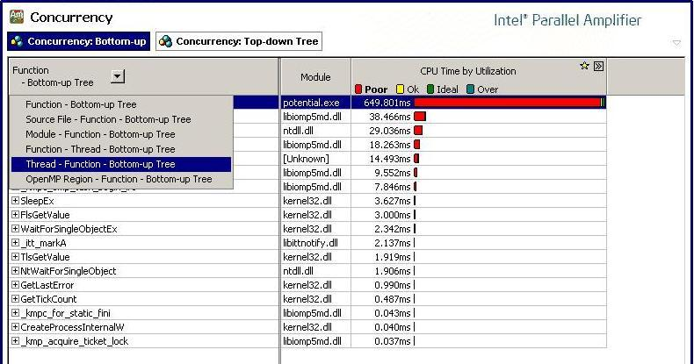
Cargas de trabajo Desbalanceadas
Notes:
Intel Parallel Amplifier Speaker’s Notes
Purpose of the Slide
Show how Load Imbalance between thread workloads can be identified from Parallel Amplifier.
Details
This example is the OpenMP version of the “potential” physics code on 16 threads (8 cores, 16 threads).
Use the drop-down (boxed arrow) in the left-most column header to configure the grouping of the data Concurrency analysis results with:
Thread - Function - Bottom-up Tree - this option is used to view the concurrency data for a specific thread and functions
BUILD: Arrows to point out selection sequence

Slide 23
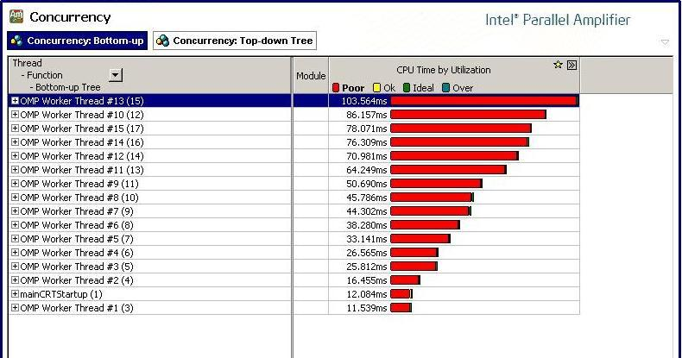
Cargas de trabajo Desbalanceadas
Notes:
Intel Parallel Amplifier Speaker’s Notes
Purpose of the Slide
Show how Load Imbalance between thread workloads can be identified from Parallel Amplifier.
Details
BUILD: Arrow appears and then points out the different amounts of CPU time each thread spent in execution.
The regularity of the differences would seem to indicate that there is a regular pattern of work drop off per assigned thread in the default division of loop iterations.

Slide 24
Actividad 2 – Carga Desbalanceada
La versión paralela de el programa “Friendly Numbers”
  Tiene un problema de rendimiento por balanceo de carga
Notes:
Multi-core Programming: Intel Thread Profiler for Explicit Threads Speaker’s Notes
Purpose of the Slide
Introduce the Second Lab Activity.

Slide 25

Sincronización
Por definición, la sincronización serializa la ejecución
Contención de locks significa que los hilos estarán ociosos durante más tiempo
Hilo 0
Hilo 1
Ocupado
Ocioso
Hilo 2
En Sección crítica
Hilo 3
Tiempo
Notes:
Intel Parallel Amplifier Speaker’s Notes
Purpose of the Slide
Give a graphical example of why synchronization contention is a bad thing.
Transition Quote
“If you know that you have a synchronization problem, how can you fix it?”

Slide 26
Arreglos en la Sincronización
Elimina sincronización
  Cara pero necesaria “mal necesario”
  Usar almacenamiento local en los hilos
    Usar variables locales para resultados parciales, actualiza globales después de los cálculos locales
    Asigna espacio en el stack del hilo (alloca)
    Usar la API de almacenamiento local en los hilos (TlsAlloc)
  Usar actualizaciones atómicas cada que sea posible
    Algunas actualizaciones de datos globales pueden usar operaciones atómicas (Interlocked API family)
Notes:
Multi-core Programming: Intel Thread Profiler for Explicit Threads Speaker’s Notes
Purpose of the Slide
Provide some potential solutions to eliminating the need for synchronization objects.
Details
The best solution would be to eliminate all synchronization, but this is likely not going to be possible in order to keep the application correct.
Alternatives to explicit synchronization are use of local storage or replace with atomic operations.

Slide 27
Actualizaciones Atómicas
Usar los bloques de construcción de OpenMP para si es posible, poner en regiones críticas
static int counter;
// Rápido
#pragma omp atomic
counter++;
// Lento
#pragma omp critical (cLock)
counter++;
Notes:
Intel Parallel Amplifier Speaker’s Notes
Purpose of the Slide
Review use atomic constructs
Details
The code segments are equivalent, but the first will execute much faster than the second.
Background
The basic Interlocked* intrinsics includes: InterlockedAdd, InterlockedAnd, InterlockedBitTestAndReset, InterlockedCompareExchange, InterlockedDecrement, InterlockedExchange, InterlockedIncrement, InterlockedOr, and InterlockedOr. Some of these have several variations on bit-size for operands and memory access semantics. See http://msdn.microsoft.com/library/default.asp?url=/library/en-us/dllproc/base/interlockedincrement.asp for more details.

Slide 28
Arreglos en la sincronización
Reduce el tamaño de las regiones críticas protegidas por objetos de sincronización
  Regiones críticas grandes retienen objetos de sincronización durante más tiempo; otros hilos están ociosos más tiempo esperando adquirir los objetos
  Solo los accesos a variables compartidas necesitan protegerse
Notes:
Intel Parallel Amplifier Speaker’s Notes
Purpose of the Slide
Provide potential solutions to reducing the time spent in critical regions of code.
Details
If there are only 2 lines that need mutual exclusion protection within a set of 25 lines, rather than protect the entire block, focus the synchronization on the two required lines.

Slide 29
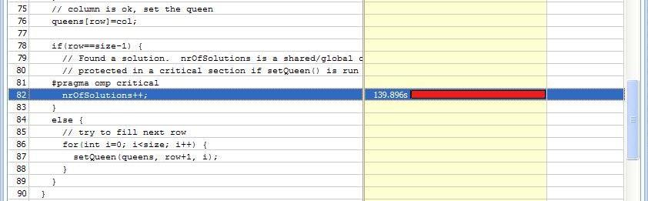
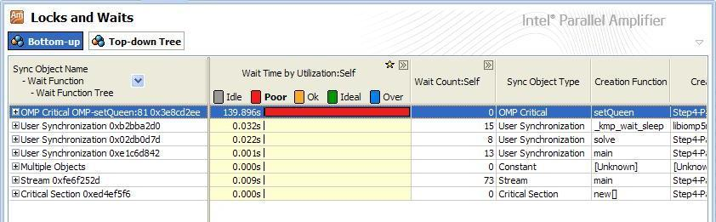
Contención de objetos
Del análisis de Locks y Waits, escoge el objeto con más pobre utilización del CPU
Haz Double-click en el nombre del objeto de sincronización para ir a la línea de código fuente
Notes:
Intel Parallel Amplifier Speaker’s Notes
Purpose of the Slide
Demonstrate how synchronization object contention is identified in Parallel Amplifier
Details
BUILD: Bring up second text bullet point and source code line from Parallel Amplifier.
Once user has found point with n the source of the object causing the problems, code should attempt to be restructured to use private variables, reductions or atomic protection.

Slide 30
Actividad 3
La versión paralela de integración numérica
  Tiene serios problemas de rendimiento
Meta
  Entender la actividad de los hilos
  Usar Parallel Amplifier para examinar la sincronización y su efecto en el rendimiento
  Arreglar el problema de rendimiento
Notes:
Intel Parallel Amplifier Speaker’s Notes
Purpose of the Slide
Introduce the Third Lab Activity.

Slide 31
Optimizaciones Generales
Optimizaciones Seriales
  Optimizaciones seriales a lo largo de la ruta crítica debe afectar tiempo de ejecución
Optimizaciones Paralelas
  Reducir contención de objetos de sincronización
  Balancear carga de trabajo
  Paralelismo funcional
Analiza el beneficio de incrementar el número de procesadores
Analiza el efecto de incrementar el número de hilos en un rendimiento escalable
Notes:
Multi-core Programming: Intel Thread Profiler for Explicit Threads Speaker’s Notes
Purpose of the Slide
Present advice on general tuning and some specific tuning advice for parallel applications.
Details
Always do serial optimizations and library substitution before starting to thread applications. It is embarrassing to have spent several months threading a code only to make some serial modifications that then make all the threading effort slow the code down because the granularity of the computations has been severely reduced.
What about scaling? How will more cores affect execution time, especially in the face of increased data set sizes?

Slide 32
Intel® Parallel Amplifier
Que se Cubrió
Identificar problemas de rendimiento puede ser complicado sin herramientas
Las herramientas se requieren para entender y optimizar la eficiencia paralela y la utilización del hardware
El Parallel Amplifier ayuda a entender la actividad de los hilos en las aplicaciones, utilización del sistema, y rendimiento escalable
Notes:
Intel Parallel Amplifier Speaker’s Notes
Purpose of the Slide
Summary slide of what has been covered in module.

Slide 33

Notes:
This should always be the last slide of all presentations.

