Slide 1
Corrigiendo Errores en la Paralelización con Intel® Parallel Inspector

Slide 2
Objetivos
Al término de este módulo, será capaz de:
  Usar Parallel Inspector para detectar e identificar una variedad de problemas de correctud de la paralelización en aplicaciones con hilos
  Determinar si las funciones de librería son “thread-safe”
Notes:
Intel Parallel Inspector Speaker’s Notes
Purpose of the Slide
Present the objectives of this module.
Details
Thread safety within libraries is an important issue, especially for third-party libraries.

Slide 3
Agenda
¿Qué es Intel® Parallel Inspector?
Detectando condiciones de concurso
Detectando interbloqueos potenciales
Verificar si las librerías son “thread-safety”
Notes:
Intel Parallel Inspector Speaker’s Notes
Purpose of the Slide
Present the topics of the module.

Slide 4
Motivación
Desarrollar aplicaciones con hilos puede ser una tarea completa
Nuevos problemas a causa de la interacción entre hilos concurrentes
  Condiciones de concurso o conflictos en el almacenamiento
    Más de un hilo accede memoria sin sincronización
  Deadlocks
    Un hilo espera un evento que nunca sucederá
Notes:
Multi-core Programming: Intel Thread Checker Speaker’s Notes
Purpose of the Slide
Provide some motivation to studying the Intel Thread Profiler.
Details
It is hard to locate and identify errors in threaded applications, especially when using standard debugging tools and techniques. The list is some of the correctness issues posed by multithreaded apps that are not found in serial codes. (These should be a quick review from previous modules.)

Slide 5
Intel® Parallel Inspector
Herramienta de depuración para software multihilos
  Complemento de Microsoft* Visual Studio*
Encuentra errores en software multihilos
Localiza los errores rápidamente que pueden llevar días usando métodos y herramientas tradicionales
  Aísla problemas, no los síntomas
  Un error no tiene que ocurrir para encontrarlo
Notes:
Intel Parallel Inspector Speaker’s Notes
Purpose of the Slide
Show off some of the features and uses of Parallel Inspector.
Details
Helps to find all of those common pitfalls!
The Symptoms are not demonstrated with Parallel Inspector, it goes beyond that and actually isolates the problems.
(While the bug does not need to occur, the code containing the bug must be executed. This point is made again in 2 slides)

Slide 6
Características de Intel® Parallel Inspector
Soporta diferentes compiladores
  GNU C
  Microsoft* Visual* C++ .NET*
  Intel Parallel Composer
Ver código fuente para diagnósticos
Ayuda de Un-click para diagnósticos
  Posibles causas y sugerencias para solucionarlo
Notes:
Intel Parallel Inspector Speaker’s Notes
Purpose of the Slide
Provide information on supported compilers and some of the features of the tool.
Details
If code contains user-defined synchronization, Parallel Inspector will not be able to identify these (only the standard API sync). Thus, an API has been developed to denote user-defined sync methods. This assumes that the sync methods work correctly, of course.

Slide 7
Parallel Inspector: Análisis
Dinámico como se ejecuta el software
  Datos (workload) – arrojados por la ejecución
Incluye monitoreo de:
  Hilos y APIs de Sincronización usadas
  Orden de ejecución de hilos
    El planificador impacta en los resultados
  Accesos a memoria entre hilos
El código debe ejecutarse para ser analizado
Notes:
Intel Parallel Inspector Speaker’s Notes
Purpose of the Slide
Present the idea that Parallel Inspector is a dynamic tool and list what information TC will gather.
Details
Threading errors do not need to appear during Parallel Inspector analysis, but the code containing bugs must be instrumented and executed in order for the tool to identify these bugs. There is no way for Parallel Inspector to perform any kind of static analysis on parts of code that are not executed, nor can TC find problems in portions of the application or DLLs that are not instrumented.

Slide 8
Parallel Inspector: Antes de Comenzar
Instrumentación: background
  Añade llamadas a la librería para registrar información
    Hilos y APIs de sincronización
    Accesos a memoria
  Incrementa el tiempo y tamaño de ejecución
Usar conjuntos de datos pequeños
  El tiempo y espacio de ejecución se expande
  Múltiples ejecuciones sobre diferentes rutas dan mejores resultados
La selección de carga de trabajo es importante
Notes:
Intel Parallel Inspector Speaker’s Notes
Purpose of the Slide
Introduce the idea of instrumentation and the consequences of such instrumentation.

Slide 9
Consejos para la Carga de Trabajo
Ejecutar el código problema una vez por hilo a identificarse
Utilizar el conjunto de datos de trabajo lo más pequeño posible
  Minimizar el tamaño del conjunto de datos
    Tamaños de imágenes más pequeños
  Minimizar iteraciones de ciclos o escalas de tiempo
    Simula minutos en vez de días
  Minimizar tasas de actualización
    Menos cuadros por segundo
Encuentra errores de paralelización más rápido
Notes:
Multi-core Programming: Intel Thread Checker Speaker’s Notes
Purpose of the Slide
Give some hints about how to decrease the execution time of TC analysis by data set reduction.
Details
Threaded and concurrent code with errors only needs to be executed once.
If a reduction of data size cannot be easily achieved, the analysis can be terminated from the VTune GUI after a sufficient time has elapsed to reach and execute the threaded code of interest.

Slide 10
Compilando para el Parallel Inspector
Compilar
  Genera información simbólica (-g)
  Deshabilita optimizaciones (-O0)
Notes:
Intel Parallel Inspector Speaker’s Notes
Purpose of the Slide
Present the minimum compilation and linking requirements needed to run Parallel Inspector analysis.
Details
Use symbols so that Parallel Inspector can show source code.
Aggressive levels of optimization can modify the order of code within an application. Disabling optimization will keep the binary code closer to the originally written source. Thus, with symbol information included, it will be much easier for Parallel Inspector to point out the lines of source that are involved in any threading errors that are identified. If a code displays threading errors with high-level optimizations (/O3), but doesn’t have any errors with optimization disabled, the problem is more likely with the compiler than with the threads in the application. (Besides, when using Parallel Inspector, we are not interested in the performance of the app, except to be sure we get some answers in a reasonable amount of time.)

Slide 11
Instrumentación binaria
Construir binario con un compilador soportado
Ejecutando la aplicación
  Debe ejecutarse dentro del Parallel Inspector
  La aplicación es instrumentada cuando se ejecuta
Notes:
Intel Parallel Inspector Speaker’s Notes
Purpose of the Slide
Discuss what binary optimization is and how this is used within Parallel Inspector.
Details
Binary instrumentation adds code to application at thread API calls, memory access points, etc. (This is why the /FIXED:NO link option is required.)

Slide 12
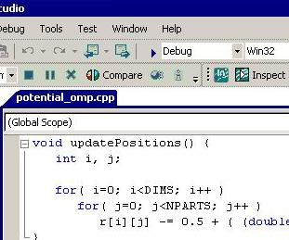
Iniciando con Parallel Inspector
Construye la versión Debug de la aplicación estableciendo las banderas apropiadamente
Notes:
Intel Parallel Inspector Speaker’s Notes
Purpose of the Slide
Remind the students to use the debug build of the application for Parallel Inspector Analysis

Slide 13
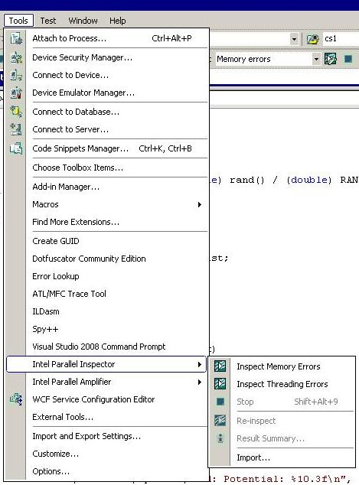
Iniciando con Parallel Inspector
Selecciona Parallel Inspector del menú de herramientas
Puedes seleecionar para buscar
  Errores de la memoria
  Errores de la paralelización
Notes:
Intel Parallel Inspector Speaker’s Notes
Purpose of the Slide
Show the students where to find the Parallel Inspector launching command to select the Threading Errors analysis.

Slide 14
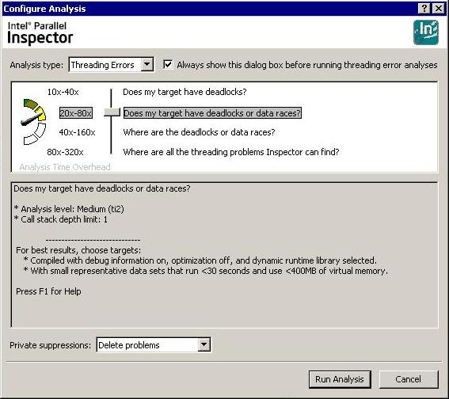
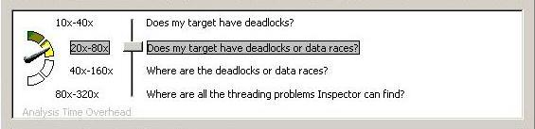
Iniciando con Parallel Inspector
Aparece la ventana de Configración del Análisis
Selecciona el nivel de análisis que será llevado a cabo por Parallel Inspector
El análisis más profundo, el más completo en resultados y el más largo en tiempo de ejecución
Click en Run Analysis
Notes:
Intel Parallel Inspector Speaker’s Notes
Purpose of the Slide
Show the students the features of the Configure Analysis window.
Details
The Intel(R) Parallel Inspector offers preset configuration levels to control result scope. Each higher preset configuration level increases both result scope and analysis cost. The level of instrumentation and amount of extra time spent in execution during the analysis of the application is chosen from the slider bar in the top half of the window. For each choice, the bottom half of the window gives some details of the analysis to be performed.
BUILD: Zoom in on analysis level choice window.
Level: Does my target have deadlocks? (ti1)
Notes: Overhead proportional to the number of locking calls
Use only to verify target has no threading issues. If Inspector detects issues, rerun analysis at a higher level to get the additional information needed to fix issues.
Level: Does my target have deadlocks or data races? (ti2)
Note: Use small, representative data sets that run less than 30 seconds and use less than 400MB of virtual memory.
Level: Where are the deadlocks or data races? (ti3)
Note: Use small, representative data sets that run less than 20 seconds and use less than 200MB of virtual memory.
Level: Where are all the threading problems Inspector can find? (ti4)
Note: Use small, representative data sets that run less than 10 seconds and use less than 100MB of virtual memory.
About Private Suppression Rules
Use private suppression rules to help you focus on bugs unique to your personal work environment.
The typical workflow for defining and applying private suppression rules:
1. When you run an analysis, configure the analysis to apply all private suppression rules in one of the following ways:
a. Limit result data by not collecting data that matches private suppression rules (Delete Problems).
b. Collect but strike through result data that matches private suppression rules (Mark Problems).
2. Interpret result data. If you encounter result data that doesn't currently require your attention, create a private suppression rule and store it in a My Inspector Results\suppressions\*.sup file in the solution folder. The Intel(R) Parallel Inspector strikes through all result data that matches the private suppression rule. If necessary, fine-tune the rule.
3. Repeat steps 1 and 2 as necessary.
Once the level is chosen, the user clicks on the Run Analysis button in the lower right corner.
BUILD: Highlight Run Analysis button.

Slide 15
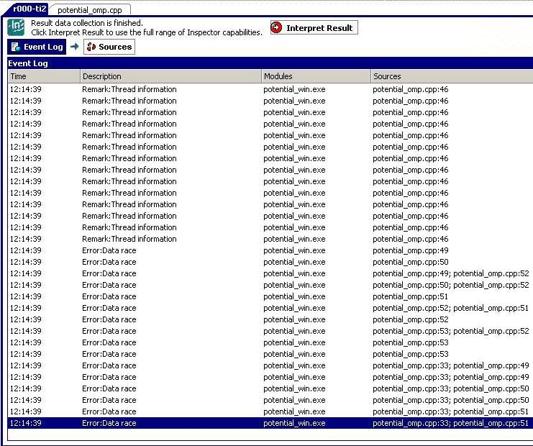
Iniciando con Parallel Inspector
Los resultados iniciales (crudos) vienen después del análisis
Haz click en el botón “Interpret Results” para filtrar los datos crudos en resultados más entendibles
Notes:
Intel Parallel Inspector Speaker’s Notes
Purpose of the Slide
Show the students the initial format of results after the analysis has been run.
Details
Intel(R) Parallel Inspector result data helps you identify underlying issues as well as discrete defects by highlighting relationships among source code locations.
The details of this transition format aren’t easily interpreted by users. You can see that there were some data races and the source lines that they occurred on. After clicking on the Interpret Results button, the raw data will be filtered and collected into easier categories to assist in quickly finding the causes of each data race.

Slide 16
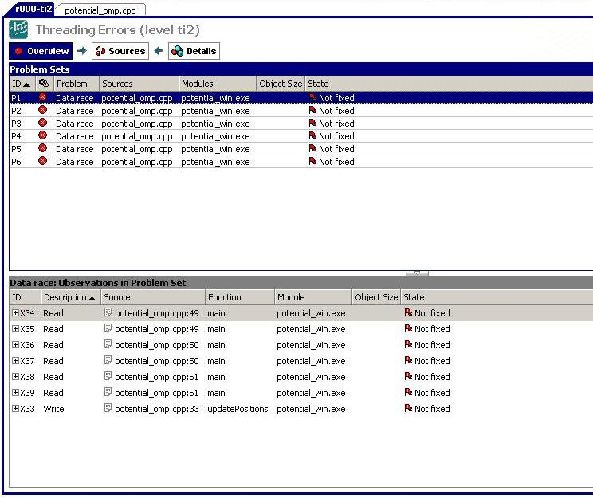
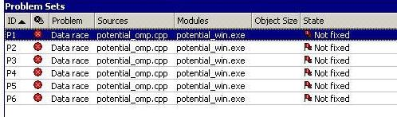
Iniciando con Parallel Inspector
Los resultados del análisis se reúnen en categorías relacionadas
Haz Doble-click en una linea del pánel de conjuntos de problemas para ver el código fuente que generó el diagnóstico
Notes:
Intel Parallel Inspector Speaker’s Notes
Purpose of the Slide
Show the students the interpreted results.
Details
This is the default starting point for managing result data. Use to review problem sets, choose problem sets of interest, and focus on observations in problem sets. Think of the Problem Sets pane at the top of this window as a to-do list: start at the top and work your way down.
The details in the Observations pane are used to review observations related to the observation selected in the Problem Sets pane, and choose focus observations. These are the observed instances of the data race during the analysis run and are collected within the single problem (diagnostic) in the upper Problem Set pane.
BUILD: Zoom in on the Problem Sets pane

Slide 17
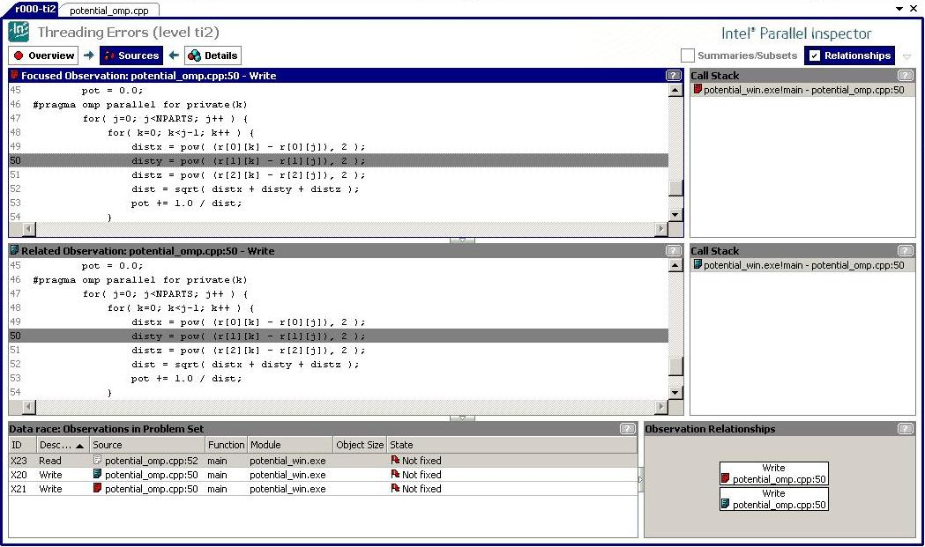
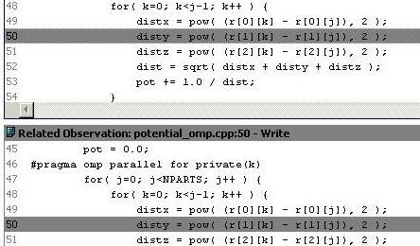
Iniciando con Parallel Inspector
Se pueden ver las líneas del código fuente involucradas en la condición de concurso
Notes:
Intel Parallel Inspector Speaker’s Notes
Purpose of the Slide
Show the students the source code view.
Details
The top two panes show what each of two threads running the application were executing concurrently that caused a data race. In the case shown it is the same line that is updating the shared variable disty. To the right is the call stack for each source line. This allows the user to quickly locate how each thread got to that point within the execution of the app. (The example has the parallel region in the main routine, so there call stack is not too interesting here.)
The bottom pane shows other observations related to the variables involved in the displayed data race. Use to review related observations, replace the focus observation for the Focus Observation Code pane with another focus observation, replace the related observation for the Related Observation Code pane with another related observation, and resolve issues.
In this case, the top line notes that there is a read-write data race with line 50 and line 52 where the disty variable is being read to compute the dist value.
BUILD: Zoom in on source lines.

Slide 18
Actividad 1a – Energía Potencial
Crear y ejecutar la versión serial
Crear la versión paralelizada
Ejecutar la aplicación en el Parallel Inspector para identificar problemas con la paralelización
Notes:
Multi-core Programming: Intel Thread Checker Speaker’s Notes
Purpose of the Slide
Introduce the first half of the First Lab Activity.

Slide 19
Condiciones de Concurso
El orden de ejecución se asume pero no puede garantizarse
  Acceso concurrente a la misma variable por varios hilos
El error más común en programas multihilos
No siempre obvios
Notes:
Multi-core Programming: Intel Thread Checker Speaker’s Notes
Purpose of the Slide
(Introduce?) Review of Race Condition

Slide 20
Resolviendo Condiciones de Concurso
Solución: Variables locales en los hilos
Cuando usarlas
  Valor calculado no se usa fuera de la región paralela
  Variables temporales o de trabajo
Cómo implementar
  OpenMP cláusulas (private, shared)
  Declara variables dentro de las funciones de los hilos
  Asigna las variables dentro del stack del hilo
  TLS (Thread Local Storage) API
Notes:
Multi-core Programming: Intel Thread Checker Speaker’s Notes
Purpose of the Slide
Detail the FIRST method that can be employed to solve Data Races.
Details
Implementations are given for many different threading models.

Slide 21

Resolviendo Condiciones de Concurso
Solución: Controla el acceso compartido con regiones críticas
Cuando usar
  El valor calculado se usa fuera de la región paralela
  El valor compartido es requerido por cada hilo
Cómo implementar
  Exclusión mutua y sincronización
  Locks, semáforos, eventos, secciones críticas, operaciones atómicas…
  Regla del pulgar: Usar un lock por elemento de datos
Notes:
Multi-core Programming: Intel Thread Checker Speaker’s Notes
Purpose of the Slide
Detail the SECOND method that can be employed to solve Data Races.
Details
The set of sync objects available will be determined by the threading model used..
Transition Quote
“Now that we’ve reviewed some of the ways to solve data races, let’s apply them to the potential energy code that we’ve analyzed with Thread Checker.”

Slide 22
Actividad 1b – Energía Potencial
Arreglar los errores encontrados con el Parallel Inspector
Notes:
Intel Parallel Inspector Speaker’s Notes
Purpose of the Slide
Introduce the second half of the First Lab Activity.

Slide 23
Deadlock (interbloqueo)
Causado por un hilo que espera un evento que nunca ocurrirá
La causa más común es jerarquía en los bloqueos
  Siempre bloquea y desbloquea en el mismo orden
  Evita jererquías si es posible
void *threadA(void *arg)
{
pthread_mutex_lock(&L1);
pthread_mutex_lock(&L2);
processA(data1, data2);
pthread_mutex_unlock(&L2);
pthread_mutex_unlock(&L1);
return(0);
}
ThreadB: L2, después L1
void *threadB(void *arg)
{
pthread_mutex_lock(&L2);
pthread_mutex_lock(&L1);
processB(data2, data1) ;
pthread_mutex_unlock(&L1);
pthread_mutex_unlock(&L2);
return(0);
}
ThreadA: L1, después L2
Notes:
Multi-core Programming: Intel Thread Checker Speaker’s Notes
Purpose of the Slide
Review concept of deadlock and give an example of locking hierarchies that lead to deadlock.
Details
It should be hoped that a single programmer that was writing both routines would not do this. However, if two separate coder were involved, they would both know that specs and need for mutual exclusion, but could still cause the example hierarchy.
Transition Quote
“This is a pretty obvious mistake and could be easily found and avoided. What about a more subtle case?”

Slide 24
Deadlock (interbloqueo)
Añade un lock por elemento
Bloquea solo elementos, no todo el arreglo de elementos
typedef struct {
// some data things
SomeLockType mutex;
} shape_t;
shape_t Q[1024];
void swap (shape_t a,
shape_t b)
{
lock(a.mutex);
lock(b.mutex);
// Swap data between a & b
unlock(b.mutex);
unlock(a.mutex);
}
Hilo 1
swap(Q[34], Q[986]);
Tomar mutex 34
Tomar mutex 986
Hilo 4
swap(Q[986], Q[34]);
Notes:
Multi-core Programming: Intel Thread Checker Speaker’s Notes
Purpose of the Slide
Another example of how deadlock might show up in the execution of a threaded application.
Details
If two threads will be accessing different elements of an array, why should we lock the whole array to allow only one thread to access at a time?
Build Points:
1: In order to improve performance, we can add a lock to each element of an array rather than one to protect the whole array.
2: If we need to swap elements, we can write one routine that always locks the elements in the same order to avoid a locking hierarchy problem.
3: But, what if thread 1 wants to swap elements 34 and 986 while…
4: Thread 4 wants to swap elements 986 and 34?
5: We have created a deadlock if each thread gains access to their first lock before trying to access the lock held by the other thread.
Questions to Ask Students
Q: Is there anyway to guarantee that this locking hierarchy won’t happen?
A: Maybe. It seems any solution will require checking the memory address of each lock and then locking them in some order (lowest first). This would add quite a bit of overhead and would be especially wasteful if this condition happened only every 1 out of 100 million times.

Slide 25
Sección Crítica en Windows*
Ligero, entre procesos solo mutex
El más útil y más usado
Nuevo tipo
  CRITICAL_SECTION cs;
Operaciones de crear y destruir
  InitializeCriticalSection(&cs)
  DeleteCriticalSection(&cs);
Notes:
Multi-core Programming: Programming with Windows* Threads Speaker’s Notes
Purpose of the Slide
Present initial description of Windows critical section object.
Details
Better mutex mechanism.
New data type used to declare objects. Critical Sections must be initialized before first use.
Background
There is a “SpinCount” variation of this object that has been tuned for use on HT systems. We do not give any information about this object within this module.

Slide 26
Sección Crítica en Windows*
CRITICAL_SECTION cs ;
Intenta entrar al código protegido
EnterCriticalSection(&cs)
  Se bloquea si otro hilo está en la sección crítica
  Regresa cuando no hay hilos en la sección crítica
Al salir de la sección crítica
LeaveCriticalSection(&cs)
  Debe ser desde el hilo que la obtiene
Notes:
Multi-core Programming: Programming with Windows* Threads Speaker’s Notes
Purpose of the Slide
Provide more details on use of Windows* critical section type.
Details
Protect critical sections (access of shared,modifiable data) of code with Enter* and LeaveCriiticalSection

Slide 27
Ejemplo: Sección Crítica
#define NUMTHREADS 4
CRITICAL_SECTION g_cs; // ¿Por qué tiene que ser global?
int g_sum = 0;
DWORD WINAPI threadFunc(LPVOID arg )
{
int mySum = bigComputation();
EnterCriticalSection(&g_cs);
g_sum += mySum; // Los hilos acceden una a la vez
LeaveCriticalSection(&g_cs);
return 0;
}
main() {
HANDLE hThread[NUMTHREADS];
InitializeCriticalSection(&g_cs);
for (int i = 0; i < NUMTHREADS; i++)
hThread[i] =
CreateThread(NULL,0,threadFunc,NULL,0,NULL);
WaitForMultipleObjects(NUMTHREADS, hThread, TRUE, INFINITE);
DeleteCriticalSection(&g_cs);
}
Notes:
Multi-core Programming: Programming with Windows* Threads Speaker’s Notes
Purpose of the Slide
Present example code demonstrating use of critical section.
Details
Point out features and function calls of example code.
Questions to Ask Students
Q: Why not just put bigComputation() into critical section?
A: Thread would exclude all other threads from running their own, independent calls to bigComputation. This would make the code serial.

Slide 28
Actividad 2 - Deadlock
Use Intel® Thread Checker para encontrar y corregir el problema potencial de deadlock.
Notes:
Multi-core Programming: Intel Thread Checker Speaker’s Notes
Purpose of the Slide
Introduce the Second Lab Activity.

Slide 29
Rutinas “Thread Safe”
Todas las rutinas llamadas concurrentemente de múltiples hilos deben ser “thread safe”
¿Cómo podemos probar “thread safety”?
  Use OpenMP y Parallel Inspector para el análisis
    Use secciones para crear ejecución concurrente
Notes:
Multi-core Programming: Intel Thread Checker Speaker’s Notes
Purpose of the Slide
Introduce the idea of thread safety
Details
Use of OpenMP can be a quick and easy method to create concurrent execution of routines.

Slide 30
Ejemplo “Thread Safety”
Verificar problemas de seguridad entre
  Múltiples instancias de routine1()
  Instancias de routine1() y routine2()
Establece secciones para probar todas las permutaciones
Aun se requiere proveer conjuntos de datos para ejercitar porciones relevantes de código
#pragma omp parallel sections
  {
  #pragma omp section
  routine1(&data1);
  #pragma omp section
  routine1(&data2);
  #pragma omp section
  routine2(&data3);
  }
Notes:
Multi-core Programming: Intel Thread Checker Speaker’s Notes
Purpose of the Slide
Give example code of using OpenMP sections to set up an application that can test for routine thread safety.
Details
Need to test routine1 to be thread safe when another thread is calling the same routine; also, want to test the thread safety of routine1 and routine2 being called concurrently.

Slide 31
Dos Formas de Asegurar “Thread Safety”
Las rutinas pueden escribirse para ser reentrantes
  Cualquiera de las variables modificadas por la rutina deben ser locales cada vez que se invoquen
    No modificar variables globalmente compartidas
Las rutinas pueden usar exclusión mutua para evitar conflictos con otros hilos
  Si no se puede evitar el acceso a variables compartidas
¿Qué sucede si librerías de terceros no son “thread safe”?
  Sería como necesitar controlar a los hilos en el acceso a la librería
Es mejor hacer una rutina reentrante que agregar sincronización
Evita potencial sobrecarga
Notes:
Multi-core Programming: Intel Thread Checker Speaker’s Notes
Purpose of the Slide
Describe two methods to ensure thread safety of user-written routines.
Details
Method one: Reentrant code.
Method two, if reentrant code is not possible: mutual exclusion code around each call.
Background
(Include any support material, stories, anecdotes, or references that might be helpful to the instructor.)
<Remove these lines and start typing here; retain the sub-heading.>
Questions to Ask Students
Q: How do you tell if third-party libraries are thread safe?
A: 1. Read the documentation.
2. Contact library author (especially if documentation is unclear or does not address the issue)
3. Test with Thread Checker (especially if you don’t trust the library author)

Slide 32
Actividad 3 – Thread Safety
Usar OpenMP para llamar funciones de librería concurrentemente
  Tres llamadas de librería = 6 combinaciones por probar
    A:A, B:B, C:C, A:B, A:C, B:C
Notes:
Multi-core Programming: Intel Thread Checker Speaker’s Notes
Purpose of the Slide
Introduce the Third Lab Activity.

Slide 33
Intel® Parallel Inspector
Lo Que se Cubrió
Los errores de paralelización son fáciles de introducir
Depurar esos errores por técnicas tradicionales es difícil
Intel® Parallel Inspector encuentra esos errores
  Los errores no tienen que ocurrir para detectarse
  Reduce gratamente el tiempo de depuración
  Mejora la robustez de la aplicación
Notes:
Multi-core Programming: Intel Parallel Inspector Speaker’s Notes
Purpose of the Slide
Summary slide.

Slide 34

Notes:
This should always be the last slide of all presentations.

